Slide 1
How to find out who has deleted Azure Data Factory or other Resources in Azure?

Slide 2
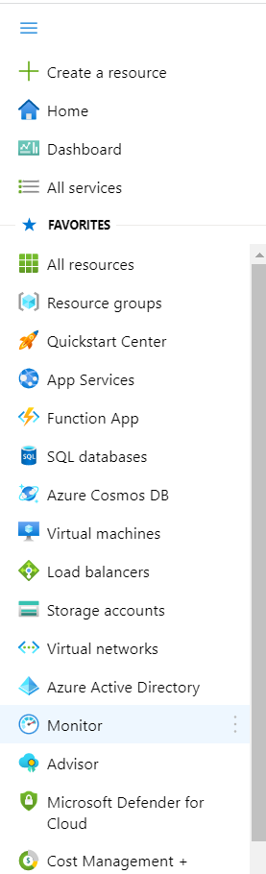
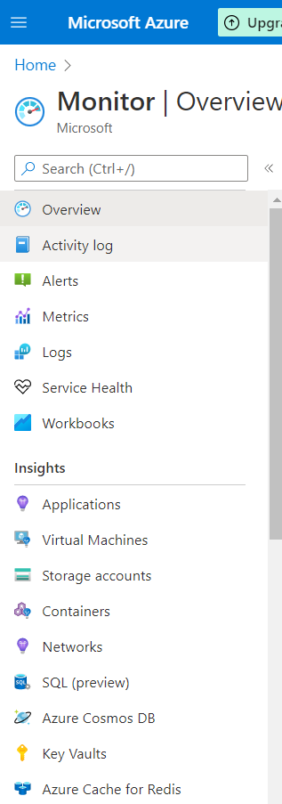

Slide 3
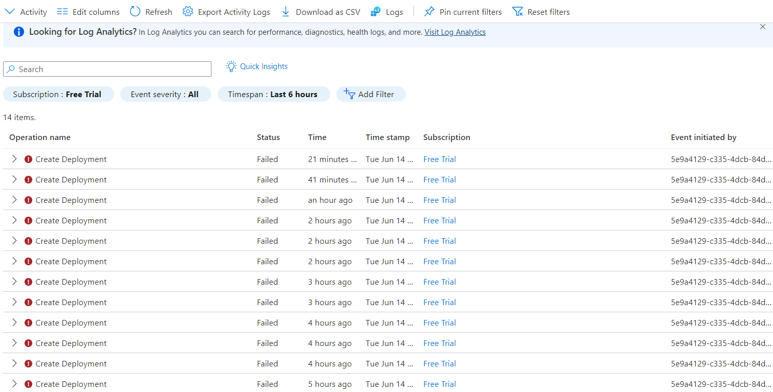

Slide 4
